Slide 1
IMPORTANT: Note for Trainers
Please read all the Hidden Slides in this Power Point file even if you are a very experienced trainer
They give you lots of background info and tips to make this training session a success
When you move to Presentation Mode and run the Slide Show, these Hidden Slides will not display

Slide 2
Hidden Slide Print out these slides as your Training Notes
Print them out by going to the Print menu
Select the ‘6 Slides – Horizontal’ handout mode
Both hidden slides and display slides will print out

Slide 3
Hidden slide IMPORTANT info for trainers
You must have online access to deliver this module
You may need to prepare in advance to register multiple user accounts from the same IP
This can take ages so please sort this out as soon as you know you will be running a training session

Slide 4
Hidden slide IMPORTANT info for trainers
If you know the IP address you will be using on the day you can ask the WMF tech team to lift the cap. This is best done well over several weeks in advance – it can take a lot longer
https://phabricator.wikimedia.org/maniphest/task/create/?projects=Wikimedia-Site-requests
If you don't know the IP address you can create accounts for people.
Attendees tell you what user name they want, and if you have the 'account creator' permission you can set them up (and give them the password)
For large groups, ensure there is more than one trainer in the room
Details of how to create accounts are here: https://en.wikipedia.org/wiki/Wikipedia:Account_creator
In an emergency accounts can be created on the participants mobile phones BUT this does not solve the wifi access issues

Slide 5
Hidden slide About this Module
This module provides a basic, generic structure for training entry level editors
There will be hidden slides throughout the module giving information, tips and notes for the trainer
This module will act as a base for a training session, but has room to be adapted further to suit the trainer’s preferences and needs of the participants

Slide 6
Hidden slide Hints for trainers
BEFORE YOU DELIVER THIS MODULE
If you are training a group of people from one organisation (eg dentists, arts teachers or a women’s group) you may want to customise the editing exercise on the ‘Good’ Article in this module
You may be tempted to run this exercise on screen and not create a paper handout
for many people that might work fine but for many others it will not

Slide 7
Hidden slide Hints for trainers
Creating a customised ‘Flawed’ Wikipedia page handout ready for the ‘Good’ Article editing exercise
Copy an existing Wikipedia article on a relevant subject
Add in a number of faults
Save as a PDF and check that it prints out as you expect
OR use the pre-prepared ‘flawed’ article on the African Crake which you will find on Slide 68
Go to Slide 63 for further instructions

Slide 8
Hidden slide Hints for trainers
The next slide will give you a checklist of the things you need to take with you to the training session
Liaise with Wikimedia UK HQ to confirm
Who is supplying what items
Who is printing the handouts
Some things will be supplied by the venue
Data Projector
Flip Chart
However we suggest speaking to the venue to confirm what they are supplying

Slide 9
Hidden slide Hints for trainers
Materials you need to deliver this module
Data Projector
Laptop or Tablet plus connector for data projector
Flip Chart (FC) plus FC paper and FC pens
Slide deck from Wikimedia UK HQ
Printed trainer’s notes - one set per trainer
Printed handouts
Prep and/or print PDF worksheet ‘Flawed Wikimedia Page’
Folder for notes and handouts
Highlighters
Plain A4 paper or Wikimedia notebooks
Blu tac or equivalent
Duct tape for tidying cables
Spare four way power socket adaptors

Slide 10
Hidden Slide Hints for trainers
Give participants lapel badges
We recommend self-adhesive ones which can be written on rather than printed ones
Ask participants to write their own names using a marker pen NOT a biro
They should write their names large enough to be seen from the front
Remember to give yourself a name badge too
This helps you and the participants with each other’s names
Some participants can be bad with names and this really helps them

Slide 11
Hidden slide Hints for trainers
Secure any computer power leads you can
They can be a trip hazard
Consider where participant power cables may run and if there is any way to secure those too
Make sure your training area is clear of cables
You don’t want to trip over whilst presenting!

Slide 12
A beginner’s guide to editing Wikipedia
A Wikimedia UK training module

Slide 13
Hidden slide Hints for trainers
Edit the “Your trainers for today” slide with the names and pictures of the trainers
This helps participants to identify you
While the slide displays, give a very brief verbal introduction to yourself
Keep information relevant and light – three most relevant points
Give background in WM UK and editing
Any specialist topic
Think about the info you put on your own user page

Slide 14
Your trainers for today
NAME XXXXX
NAME XXXXX

Slide 15
Hidden slide Hints for trainers
Even if everyone seems to have met everyone else before you start, a round of introductions is still worth doing
There may be someone new or quiet, who no one has really spoken to yet
Introducing yourself first helps to break the tension of going first
Ask who would like to go next
Don’t ask who would like to go first as this can create nerves
If there are no volunteers, start at the back of the room, not at the front to help break expectations

Slide 16
Introductions
Please introduce yourself in 10 seconds

Slide 17
Hidden slide Hints for trainers on Housekeeping slide
Any instructions on where to sit or what equipment to plug in
How to log on to the wifi
Where to find toilet facilities
Practical details about the room
Where to find refreshments
Planned fire alarms?
What to do in an emergency
Edit the next slide with actual times

Slide 18
Housekeeping
Practical details about this training session
Where to plug in chargers
Logging on to Wifi
Location of toilet facilities
Where to find refreshments
Planned fire alarms?
What to do in an emergency

Slide 19
Times for today
XX:XX Arrival
XX:XX Introductions, course begins
XX:XX Coffee break
XX:XX Close

Slide 20
Today’s session
What is Wikipedia
How to set up your account
What makes a good article
Getting started as an editor
How to get help when needed

Slide 21
Hidden slide Hints for trainers
If you are doing a session with a particular emphasis, you may want to amend the previous slide to reflect your subject matter

Slide 22
What is Wikimedia? Imagine a world in which every single human being can freely share in the sum of all knowledge That’s our commitment

Slide 23
The role of Wikimedia
Wikimedia is a global movement whose mission is to bring free educational content to the world
Through various projects, chapters, and the support structure of the non-profit Wikimedia Foundation, Wikimedia strives to bring about a world in which every single human being can freely share in the sum of all knowledge

Slide 24
What is Wikipedia?
Wikipedia is a very exciting project run by a diverse community of editors
It is a free encyclopaedia that anyone can edit and contribute to
It has 15 to 18 billion views per month
There are articles written in over 280 languages
It is one of the largest collaborative projects in history 70,000 people work on it every month
They are all volunteers
It relies on the contribution of people just like you
Wikimedia helps to support the editing community

Slide 25
Wikimedia is worldwide
Wikimedia is a global movement whose mission is to bring free educational content to the world

Slide 26
Wikimedia’s structure
Wikimedia’s board is composed of volunteers
Wikimedia is not just volunteers
There are staff members employed to organise, support and run different projects
The organisation is trying to encourage a more diverse community
For example, at the time of writing only 12% of editors are women
Only 12% of biographies on Wikipedia are of women

Slide 27
Hidden slide Hints for trainers
Check that participants have their reading glasses on as some of the handouts have some dense text
Use the following slide to illustrate where to find important general features of a Wikipedia page
The red boxed areas show where to find key features
Give out the slide as a paper handout before taking through the slide – many people like to write on handouts like this to jog their memories later

Slide 28
Hidden slide Hints for trainers
Use the following slide to illustrate where to find important general features of a Wikipedia page
Either use a laser pointer or indicate the general area of each box
The red boxed areas show where to find
The log in links
The article’s edit button and history
The article’s Talk page
The help button and Community portal
Links to Tools for the article

Slide 30
Setting up a Wikipedia account

Slide 31
Hidden slide Hints for trainers
Ask for a show of hands of who has a Wikipedia account already
You may have already set them up as people were arriving for the training session
Still show this slide and ask who has an account as some people may have arrived too late for this to happen

Slide 32
Good reasons for having your own Wikimedia account
It helps you to build your Wikimedia profile
It means you will be given credit for your work editing Wikipedia
You will be recognised and able to take a full part as a member of the Wikimedia Community

Slide 33
Logging in
If you have an account already, log in by clicking on the link at the top right of the Wikipedia Page on your screen
You can still edit without being logged in
Some features require a log in
If you have not created an account yet, let us know and one of the trainers will give you a hand

Slide 34
Hidden slide Hints for trainers
Ask the participants to log in to their account now
If anyone still needs to create an account, they should do so now
If anyone does need to create a new user account, make sure to warn them NOT to click the “Start editing” button at the end of account creation

Slide 35
Handout Creating a new User Account
Click on the ‘Create account’ link at the top right of a Wikipedia page
Fill in the form as required
Once your account is up and running you are logged in
You can access your User Page at any time by clicking on your user name in the top right of the page
You can toggle between your User Page and Talk Page using the links at the top left of the page

Slide 36
Creating your User page
A User Page gives basic information about you
Having a User Page helps show you are a serious editor
It should include:
Basic information about yourself and particularly interests or areas of expertise that you are happy to share
Don’t overshare!

Slide 37
Save, Preview and Show changes
These 3 buttons will be on any page you edit – including your own
They allow you to:
Save your changes
Preview what your changes will look like
See what changes you have made
To go back without saving your changes, just press cancel

Slide 38
As a new user you can get lots of tips and useful links
Type {{New user bar}} at the beginning of your user page to get set up quickly

Slide 39
Ready to edit?

Slide 40
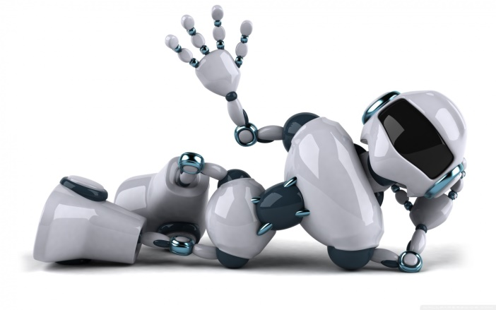
Relax!
You won’t break anything
Wikipedia is very robust
Changes can be (and often are) reverted to the previous version
There are automated programs called bots which continually scan Wikipedia for certain changes and will revert them

Slide 41
Hidden slide Trainer note
Depending on your time demands
Ask for plenary suggestions about what an edit is
Give participants a few minutes to discuss on tables before feeding back
This helps give the reflectors time to engage

Slide 42
Hidden slide Trainer note
This module focuses on using Wiki Markup (aka wikitext and wikicode)
If you want the participants to switch to Visual Editor, you will need to tell them to click on the different button

Slide 43
What is an edit?
A positive contribution to Wikimedia which could take the form of:
Correcting punctuation
Correcting typos on a page
Changing the style and tone
Removing biased content
Adding citations and references
Writing a new article

Slide 44
Editing a Wikipedia page
There are two ways of editing
Using Wiki Markup – a coding approach
Using Visual Editor which is like editing Word
Visual Editor can be used for most straightforward editing tasks
There are some complex editing tasks which need the coding approach
e.g. adding information about an animal’s species

Slide 45
Hidden slide: Hints for trainers
Blank the screen at this point using B
Draw the edit cycle on the flip chart and then show the slide with the completed version once you have finished

Slide 46
Hidden slide Hints for trainers
Draw the Edit Cycle out on the Flip Chart explaining each stage as you go along
The trainer’s note version explains the additional steps
These do not need to be written up on the board, but should be explained
To maintain visual impact please use different coloured FC pens for each stage

Slide 47
Trainers notes: The Edit Cycle
Identify the edit
Click on the
edit button
Save
Edit
Click on the
preview changes
button
Preview
and write edit summary

Slide 48
The Edit Cycle
Identify the edit
Save
Edit
Preview
and write edit summary

Slide 49
The Edit Cycle
Read the page and look for possible problems or improvements
Identify an edit you want to make
Is it an appropriate edit?
Is it needed?
Check the article’s Talk Page (we will discuss this in more detail later)
Make the edit
Be bold!
Preview the edit
Write an edit summary
Save the edit

Slide 50
The edit summary
Always write an edit summary
A summary should detail the kind of edit you have made
Give the reason why you have made an edit
This helps other editors to understand your motivation
This helps demonstrate you are a serious editor

Slide 51
Editing is the easy bit!
The mechanics of making changes and editing a Wikipedia page are relatively simple
The more complicated issues are about making sure your edits are appropriate
That is what we will cover next

Slide 52
Hidden slide: Hints for trainers
The next slide should be given as a handout as it has a useful link on it

Slide 53
Editing Wikipedia articles
To practice after this workshop you can go to:
https://en.wikipedia.org/wiki/Wikipedia:VisualEditor/User_guide

Slide 54
Hidden slide: Hints for trainers
On the next slide there is a point that articles should always be referenced
This is a demonstration of the way Wikipedia has changed
Articles did not always need references
This is a relatively recent change
It helps to improve the credibility of Wikipedia but is not always known

Slide 55
Key points about edits
No original research
Articles should summarise what others have published
They should not be drawing any new conclusions
They should be referenced
Neutral point of view
Articles should be accurate and without bias
All significant viewpoints should be considered and included

Slide 56
Key points about edits
Wikipedia articles should be written in an encyclopaedic style with a formal tone to the language

Slide 57
Not sure about an edit?
If you aren’t sure if an edit is needed, you can ask the community
Each article has its own talk page
Alternatively, try asking on the Wikipedia Teahouse
en.wikipedia.org/wiki/Wikipedia:Teahouse

Slide 58
Hidden slide Trainer note
Give out handout before going through slide
Some people will need the handout to follow the amount of information on screen
Important handout for people to take away with them

Slide 59
The Do’s of the Encyclopedic style
Try to stick to all of these
Use plain language
Be brief
Cite sources to back up factual claims
Attribute viewpoints to the people who hold them
Avoid stating conclusions
Unless attributable to specific sources

Slide 60
The Don’ts of Encyclopedic style
Things to avoid…
Create new essay-like articles or sections
Structure your writing like an argument
Use “weasel words”
Examples include “most experts agree” or “some people say”
Use colloquial language or slang
Use emotive terms
Such as “great”, “extraordinary” or “incredible”
Include personal opinion
Use very complex language and sentence structure

Slide 61
What makes a good Wikipedia article

Slide 62
Exercise – The “Good” Article?
In groups, look at the handout
Identify areas which you think need attention
Use three different highlighters to tag
Grammatical errors in one colour
Errors or problems in the text in a second colour
Missing references in a third colour

Slide 63
Hidden slide Trainer note (1)
There is a standard handout with errors included for this module – see separate PDF file
Alternatively, prepare and customise a “flawed article” handout to suit your event

Slide 64
Hidden slide Trainer note (2) Creating a customised ‘Flawed Article’
Copy the code from a good Wikipedia page (use a featured article if possible) and edit it in your sandbox to add plenty of problems
Add grammatical errors
Remove some references
Add text
Add bias
Use the wrong voice
Use weasel words
Make sure to add plenty of errors
Save as a PDF and print out as a handout

Slide 65
Hidden slide Trainer note (3)
The following handout is suitable for the “Good article” exercise
Print this out on A3 (if possible)
Tell the participants that this is not the same article as can be found online and has been altered
There are over 50 errors which have been inserted in the document
Do not tell the participants how many errors there are
You should not expect participants to identify ALL the errors
Please do not point out ones that they miss
Congratulate them on the ones they succeed in finding

Slide 66
Hidden slide Trainer note (4)
To debrief this exercise you could run through each worksheet page top to bottom
Be aware this could take a long time especially if you have a lot of participants
Or just ask for some examples of edits people would make to it to get a flavour of what people thought was an edit
If tight on time, pick out one edit from each sheet to give a little more detail on
Use Blu Tac to attach these sheets to the wall
People can then see the most commonly noticed edits and that different people spot different potential edits

Slide 67
Hidden slide Trainer note (5)
The participants don’t need to catch every mistake that you added to the page for this exercise to work
Be careful to welcome any ideas for edits that are appropriate even if they aren’t the ones you intended!
Remember this is not a “spot all the edits” test, it’s an exercise to help people see the need for collaboration in editing and see what an edit looks like
Show the next slide to reinforce the Learning Points

Slide 68
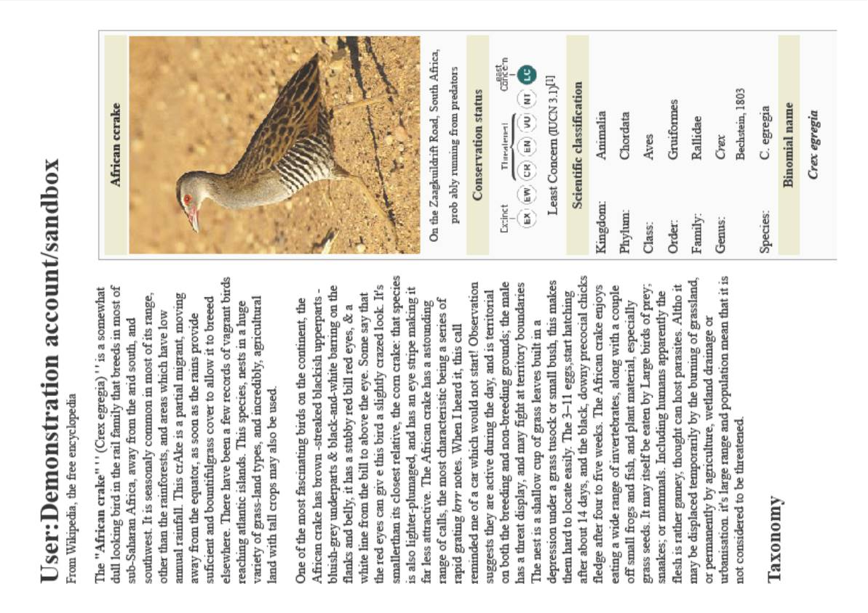

Slide 69
Is our page perfect now?
Experience tells us:
Different people will notice different errors on a page, at different times
This is why we need lots of editors
An article may need lots of edits to get it completely right
Collectively, we can make something better than we could individually do on our own – that is why Wikimedia works so well

Slide 70
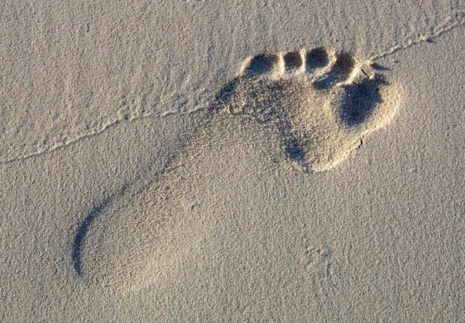
Your sandbox
Sandbox pages provide space to experiment with the process of editing Wikipedia pages
When you are logged in to your User Account you access your sandbox by clicking on the link at the top right of your screen
The first time you open your sandbox, Wikipedia will automatically create it at the same time
The next time you will need to click the edit button to change the contents of your sandbox

Slide 71
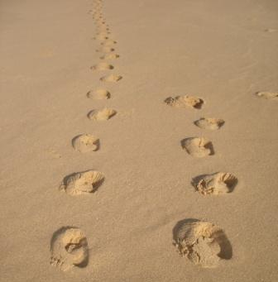
Using your sandbox
Use your sandbox to practice and experiment
Always draft new articles in your sandbox first before saving them

Slide 72
Hidden slide Customising the ‘Using your Sandbox’ exercise
If you want to create your own version of this exercise please do so
You could also create your own customised version of a handout to suit your audience if they have a common interest or occupation
If you are going to customise please make sure you do this in plenty of time
Make sure you get it proof read by someone not involved in writing the new material

Slide 73
Hidden slide Tips for trainers
Give the participants the Wiki Markup cheat sheet handout and the copy of the African Crake handout from Birdlife International (or the equivalent customised material you have prepared)
Explain they should not copy text, but must use their own words
Remind them to try to use the encyclopaedic style and tone

Slide 74
Exercise Creating your sandbox
Open your sandbox
Look at the paper handout about the African Crake
Write a short paragraph of text about the African Crake in your sandbox, using your own words
Now refer to the Wiki Markup Cheat Sheet
Make some text bold
Make some text italic
Use the codes on the cheat sheet to create the different font effects
Reference the text using the information on Part 3 of the African Crake Handout
Check the cheat sheet for the code on how to insert references

Slide 76
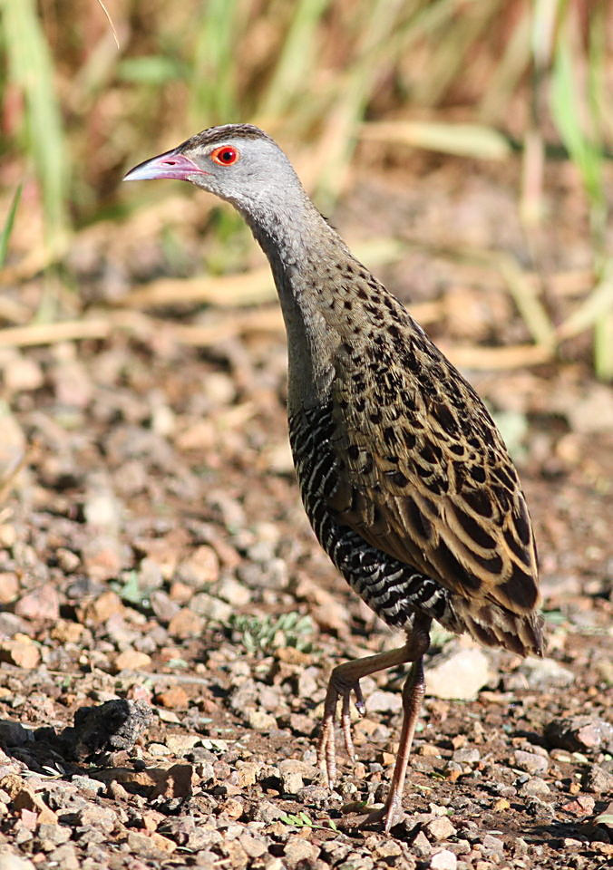
Handout Part 1 African Crake information from Birdlife International
African Crake Crex egregia
http://www.birdlife.org/datazone/speciesfactsheet.php?id=2877
Justification This species has an extremely large range, and hence does not approach the thresholds for Vulnerable under the range size criterion (Extent of Occurrence <20,000 km2 combined with a declining or fluctuating range size, habitat extent/quality, or population size and a small number of locations or severe fragmentation). The population trend appears to be stable, and hence the species does not approach the thresholds for Vulnerable under the population trend criterion (>30% decline over ten years or three generations). The population size has not been quantified, but it is not believed to approach the thresholds for Vulnerable under the population size criterion (<10,000 mature individuals with a continuing decline estimated to be >10% in ten years or three generations, or with a specified population structure). For these reasons the species is evaluated as Least Concern.
Taxonomic source(s) AERC TAC. 2003. AERC TAC Checklist of bird taxa occurring in Western Palearctic region, 15th Draft. Available at: #http://www.aerc.eu/DOCS/Bird_taxa_of _the_WP15.xls#. del Hoyo, J.; Collar, N. J.; Christie, D. A.; Elliott, A.; Fishpool, L. D. C. 2014. HBW and BirdLife International Illustrated Checklist of the Birds of the World. Barcelona, Spain and Cambridge UK: Lynx Edicions and BirdLife International.
Taxonomic note Crex egregia (del Hoyo and Collar 2014) was previously placed in the genus Crecopsis.
Synonym(s) Crecopsis egregia (Peters, 1854)
Terms of Use
Trend justification The population is suspected to be stable in the absence of evidence for any declines or substantial threats.

Slide 77
Handout Part 2 African Crake information
Ecology Behaviour This species is a partial migrant, moving both north and south of the equator to breed during the rains (del Hoyo et al.1996). It breeds in solitary territorial pairs, and normally occurs singly, in pairs or family parties (Urban et al. 1986, Taylor and van Perlo 1998) outside of the breeding season, with small groups of up to six individuals occurring together on migration (Urban et al. 1986). Newly arrived migrants in both the breeding and non-breeding grounds have also been observed in groups of 3-8 individuals (Taylor and van Perlo 1998). The species is most active early and late in the day, especially after heavy rain or during light rain (del Hoyo et al. 1996). HabitatThe species shows a preference for a range of grassland habitats (del Hoyo et al. 1996, Taylor and van Perlo 1998) from seasonally moist or inundated grasslands (del Hoyo et al. 1996, Taylor and van Perlo 1998) (e.g. temporary wetlands in the moist grassland of the Okavango Delta) (Taylor and van Perlo 1998), grass and rank vegetation at the edges of freshwater swamps, reedy marshes, and open waters (Urban et al. 1986, del Hoyo et al. 1996, Taylor and van Perlo 1998) (e.g. rivers, streams and farm dams) (Urban et al. 1986), to tall grass savannas (Taylor and van Perlo 1998) and dry grassland in lightly wooded country (del Hoyo et al. 1996, Taylor and van Perlo 1998). The species also frequents grassy areas in forest clearings and occurs around exotic plantations (Taylor and van Perlo 1998), in maize, rice and cotton fields (Urban et al. 1986, del Hoyo et al. 1996, Taylor and van Perlo 1998), in neglected cultivation (del Hoyo et al. 1996, Taylor and van Perlo 1998), and in moist sugar cane plantations adjacent to marshy areas (del Hoyo et al. 1996, Taylor and van Perlo 1998). Its grassland habitat is frequently burnt in the dry season, forcing emigration (Urban et al. 1986, del Hoyo et al. 1996, Taylor and van Perlo 1998). Diet Its diet consists of earthworms, molluscs, insects and their larvae (especially termites, ants, beetles and grasshoppers), small frogs (del Hoyo et al. 1996, Taylor and van Perlo 1998), small fish (Taylor and van Perlo 1998), grass seeds (del Hoyo et al. 1996) and vegetable matter (e.g. grass blades, green shoots and other leaves) (del Hoyo et al. 1996, Taylor and van Perlo 1998). Breeding site The nest is a shallow cup of grass blades that is usually positioned on the ground in a scrape or depression, often hidden under a tussock or small bush (Urban et al. 1986, del Hoyo et al. 1996, Taylor and van Perlo 1998), occasionally also 2-15 cm above dry ground, or floating or standing in water in dense grass or other vegetation (Urban et al. 1986, del Hoyo et al. 1996, Taylor and van Perlo 1998). Threats The loss of wetland and grassland habitats due to overgrazing, cultivation (del Hoyo et al. 1996) (e.g. sugarcane plantations) (Taylor and van Perlo 1998) and human settlement is a threat to this species (Taylor and van Perlo 1998). Utilisation The species is killed for food in some regions (del Hoyo et al. 1996, Taylor and van Perlo 1998).

Slide 78
Handout Part 3 African Crake information
References del Hoyo, J.; Elliott, A.; Sargatal, J. 1996. Handbook of the Birds of the World, vol. 3: Hoatzin to Auks. Lynx Edicions, Barcelona, Spain.
Delany, S.; Scott, D. 2006. Waterbird population estimates. Wetlands International, Wageningen, The Netherlands.
Taylor, B. 1998. Rails: a guide to the rails, crakes, gallinules and coots of the world. Pica Press, Robertsbridge, UK.
Urban, E. K.; Fry, C. H.; Keith, S. 1986. The birds of Africa vol. II. Academic Press, London.
Further web sources of information Explore HBW Alive for further information on this species
Search for photos and videos, and hear sounds of this species from the Internet Bird Collection
Text account compilers Malpas, L., Ekstrom, J., Butchart, S.
IUCN Red List evaluators Butchart, S., Symes, A.
Recommended citation BirdLife International (2016) Species factsheet: Crex egregia. Downloaded from http://www.birdlife.org on 19/01/2016. Recommended citation for factsheets for more than one species: BirdLife International (2016) IUCN Red List for birds. Downloaded from http://www.birdlife.org on 19/01/2016.
This information is based upon, and updates, the information published in BirdLife International (2000) Threatened birds of the world. Barcelona and Cambridge, UK: Lynx Edicions and BirdLife International, BirdLife International (2004) Threatened birds of the world 2004 CD-ROM and BirdLife International (2008) Threatened birds of the world 2008 CD-ROM. These sources provide the information for species accounts for the birds on the IUCN Red List.
To provide new information to update this factsheet or to correct any errors, please email BirdLife

Slide 79
Reliable sources
Information should be verifiable
Sources should be published
Reliable sources
Third party sources with a reputation for fact checking
Books published by academic presses
Peer-reviewed academic journals
International newspapers
Sources should represent significant viewpoints
Not one-off studies or fringe work
Try to find the best and most reliable sources available

Slide 80
Referencing your article
Source
Web page
Printed Publication
Do you have the
full URL?
Do you have the ISBN?
Yes
No
Yes
No
Enter the information with appropriate coding
Do you have the publisher’s details?
Enter the information with appropriate coding
Go back
Yes
No
Enter the information with appropriate coding
Go back

Slide 81
Hidden slide Alternative version of flow chart
Some trainers told us they do not like using the STOP icon on the previous slide showing the flow chart
We have therefore included an alternative layout for you to use if you prefer
This alternative slide is currently hidden from display using the Hide Slide option in PowerPoint
If you want to use this second version of the slide, please right click on it on the side bar in Power Point
Then click on the Hide Slide function at the bottom of the drop down menu to unhide this slide
Now select the previous version of the slide and use the same process, this time to hide the original version of the slide

Slide 82
Referencing your article
Source
Web page
Printed Publication
Do you have the
full URL?
Do you have the ISBN?
Yes
No
Yes
No
Enter the information with appropriate coding
Do you have the publisher’s details?
Enter the information with appropriate coding
Go back
Yes
No
Enter the information with appropriate coding
Go back

Slide 83
© Copyright
All material on Wikimedia is freely licensed
This means:
People are free to share, copy or redistribute material
They can also adapt, remix, transform or build on the material
However attribution MUST be clearly shown
This means giving appropriate credit to the person who created the original material, no matter how much it has been changed

Slide 84
© Copyright continued
Except for brief attributed quotes, copying content from other copyrighted sources is not allowed on Wikipedia
All content should be written in your own words
Public domain and freely licensed content may be added as long as it is properly attributed

Slide 85
Hidden slide Tips for trainers
Re copyright
Refer back to the African Crake article

Slide 86
Conflict of interest
It’s best to avoid editing articles about
Yourself
Your employer
Organisations you belong to
Editors with conflict of interest are likely to have their edits reverted

Slide 87
What to do to avoid conflict of interest issues
Use the Talk Page to alert senior editors if you spot problems on a page where you might be seen as having a conflict of interest
These are the types of problems you may want updated or changed
Factual inaccuracies
Out of date information
Outdated photos

Slide 88
Reversion
Changes a Wikipedia article back to a previous version
This is done by more experienced editors
Any changes made to the article will be removed
Used to remove incorrect or inappropriate edits
Edits which do not follow the standard format will probably be reverted

Slide 89
Reversion is not personal
If you are unsure why your edits have been reverted, you can ask on the article’s Talk Page
You can always politely ask an editor why they have made the reversion
Most reversions are made by automatic bots
The aim is to protect Wikipedia against unexpected edits which might be vandalism

Slide 90
Avoiding reversion
Create a proper User Page
This shows you are a serious editor, not someone messing around
Reference and cite your sources properly
Check the article’s Talk Page
Post on the Talk Page to send other editors to your sandbox to see your draft article before publishing
Use the Cheat Sheet to guide you
Look at the next handout to see the time and speed of automatic reversions by Wikimedia bots
They revert edits within seconds to protect Wikipedia against vandalism

Slide 91
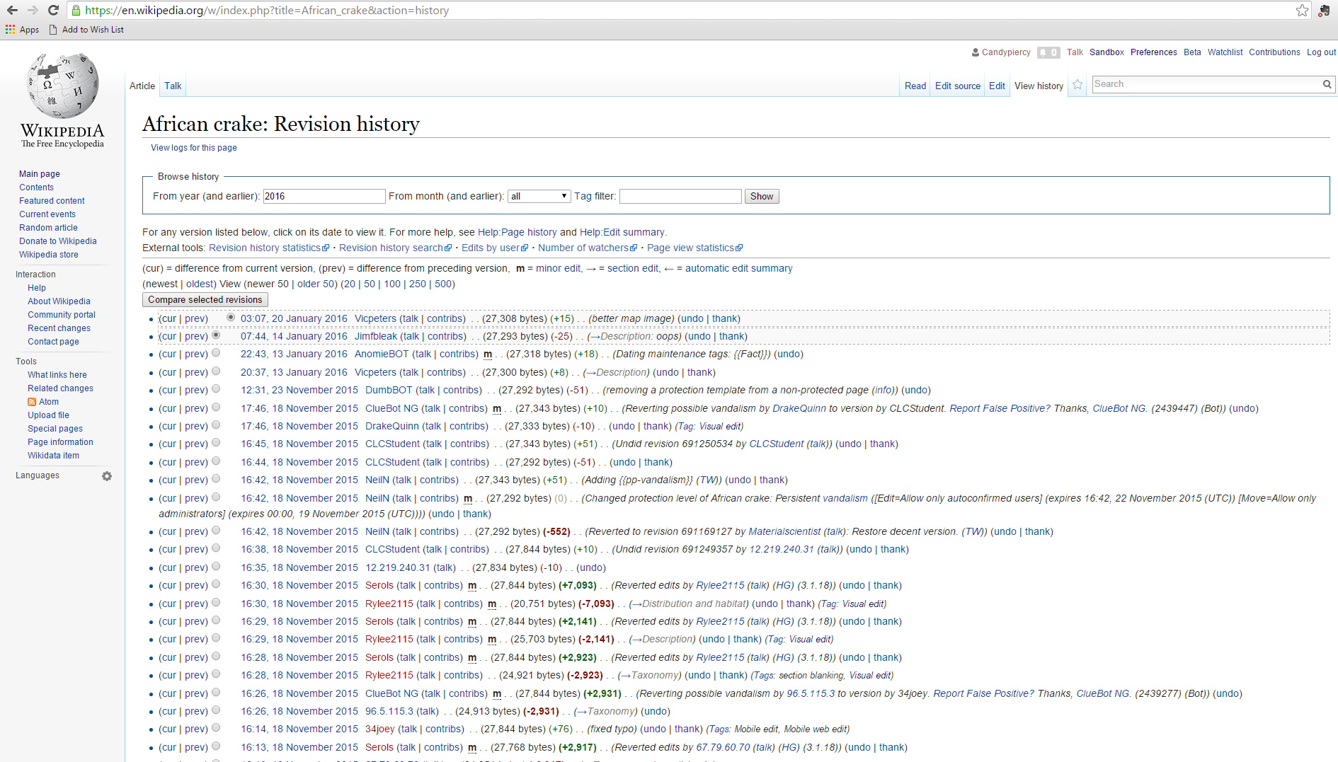
Handout: Screenshot of African Crake Page Article history

Slide 92
Hidden slide Article history
Handout of article history
Shows the participants that there are many reversions
Shows that you can still access the edits made before the article was reverted
Draw attention to the times next to the posts detailing reversion of edits

Slide 93
How to ask for help
Use the Talk Page behind every Wikipedia page
For lots more information about how to get the best out of Talk Pages go to:
Wikipedia:Talk page guidelines
Use the Teahouse
You can post questions and get a quick reply from a passing editor
Enter the following into your Wikipedia search box to take you to the Teahouse
Wikipedia:Teahouse

Slide 94
Hidden slide Trainer note
Prepare a card or sheet of A4 that can be passed around the participants using the next slide as a template
It should have the URL for the your talk page on it
Hand the sheet to one of the participants and ask them to go to your Talk Page and leave a message and sign it
When they have done this, they then pass the card on to the next participant
The second trainer/assistant can then post useful links on the participants’ talk pages as a reply

Slide 95
Visit your trainer’s Talk Page and post a message there NOW!
Your trainer is………………………
The link to their Talk Page is:
……………………………………………….
Or you could use bit.ly/

Slide 96
Visit your trainer's Talk Page
You will be given a sheet of paper with the link to your trainer’s Talk Page written on it
Please go the Talk Page and leave a message and sign it
Once you have done this, pass the paper on to the next participant who will do the same
You will then receive a message back from one of the trainers

Slide 97
Go to your trainer’s Talk Page NOW!

Slide 98
Putting it into practice!
Go and look at articles on Wikipedia which you might want to edit
See if you can spot any potential problems
Remember the Wikimedia slogan…
Be bold!

Slide 99
Hidden slide Putting it into practice
If there is time suggest the participants practice their new skills and edit onscreen
Have a set of articles you think are a good place to start
However if this session is to be followed by the companion module ‘Now you are an editor’ take a coffee break now and then start the next module

Slide 100
What is the most important thing you learned today?
Discuss in pairs
Identify one point each
The trainer will write these topics/thoughts on flip chart

Slide 101
Evaluation
Please fill in our evaluation form
It helps us to improve our training
Thanks for attending our training today!

